Slide 1
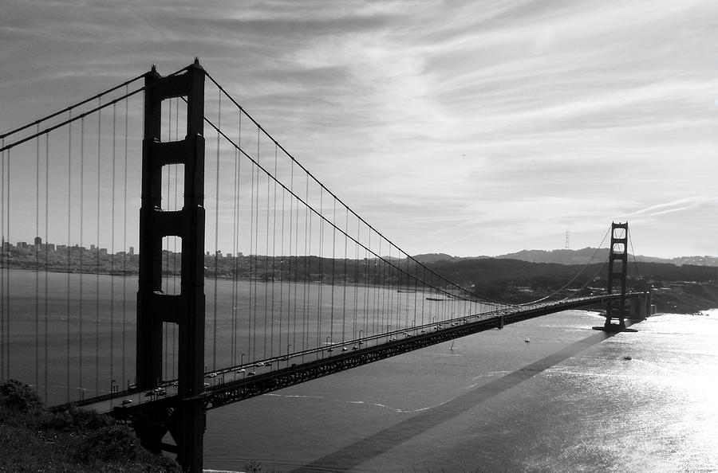
Building with the right mindset
By Iyanu Adelekan

Slide 2
So you want to be a builder?

Slide 3
That’s great.

Slide 4
But before you start bashing that keyboard to build the next Facebook…

Slide 5
let’s have a little talk.

Slide 6
Who do you think a builder is?

Slide 7
Characteristics of a builder
A builder is a problem solver.
A builder is always on the prowl for great projects to work on.
A builder is that person you go to when you want to develop your idea but you have no idea how.
A builder laughs in the face of difficult problems.

Slide 8
A builder can be found in the wild looking like…

Slide 9
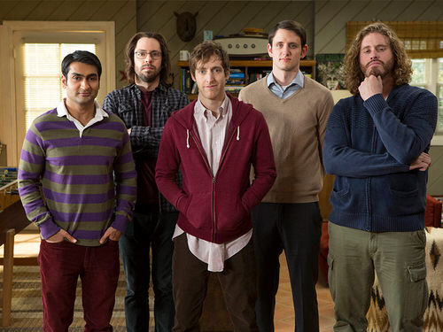

Slide 10
Becoming a builder is hard
You need to be dedicated.
You need to know a lot of technical stuff.
You need to be passionate about building.
You need to identify the kind of problems you want to solve.
You need to be extremely good add solving those problems.

Slide 11
The most important thing you’ll need to become a builder is…

Slide 12
🔥🔥🔥🔥🔑🚀🚀🔑🚀🚀the right mindset🔥🔥🔑🚀🚀🔥🔥🔥🔥🔥

Slide 13
You can build all things.
No problem is to difficult for you to solve.
There’s nothing you can’t learn to build.
There’s no one you can’t build better than.
You are the most creative person that you know.

Slide 14
Some examples of great builders are:

Slide 15
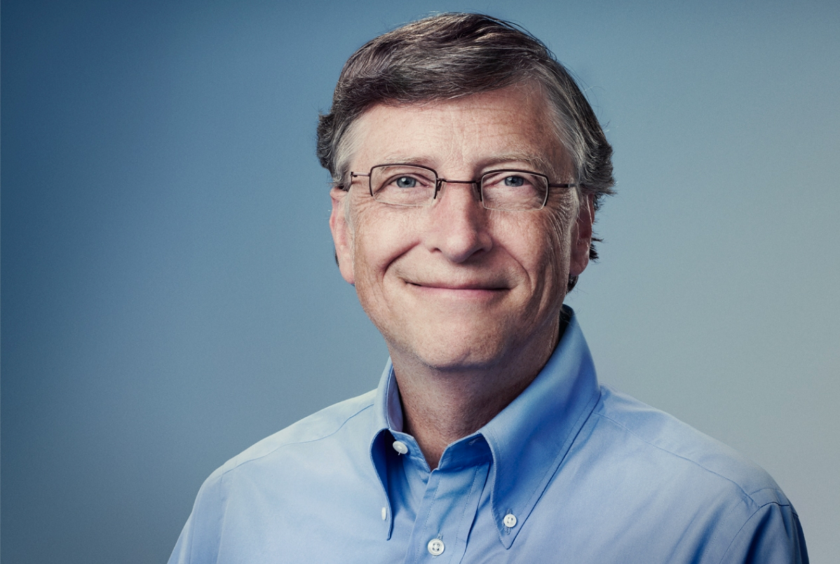

Slide 16
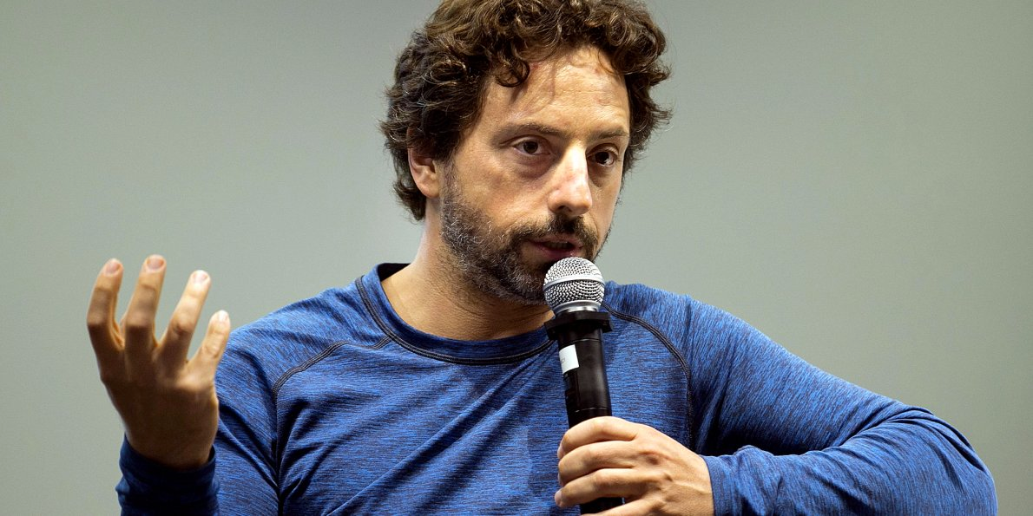

Slide 17
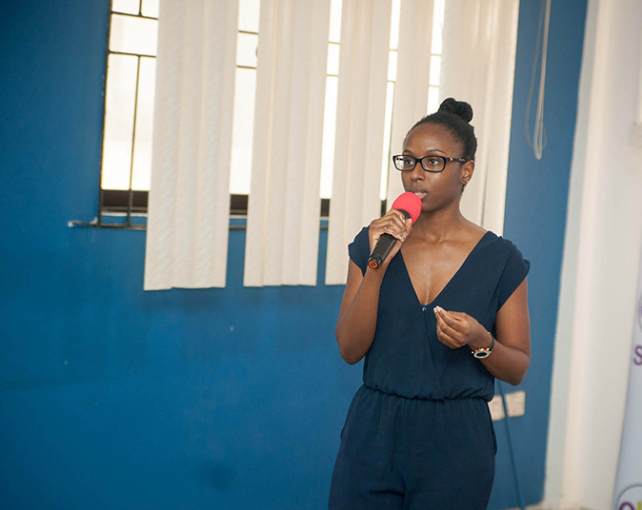

Slide 18
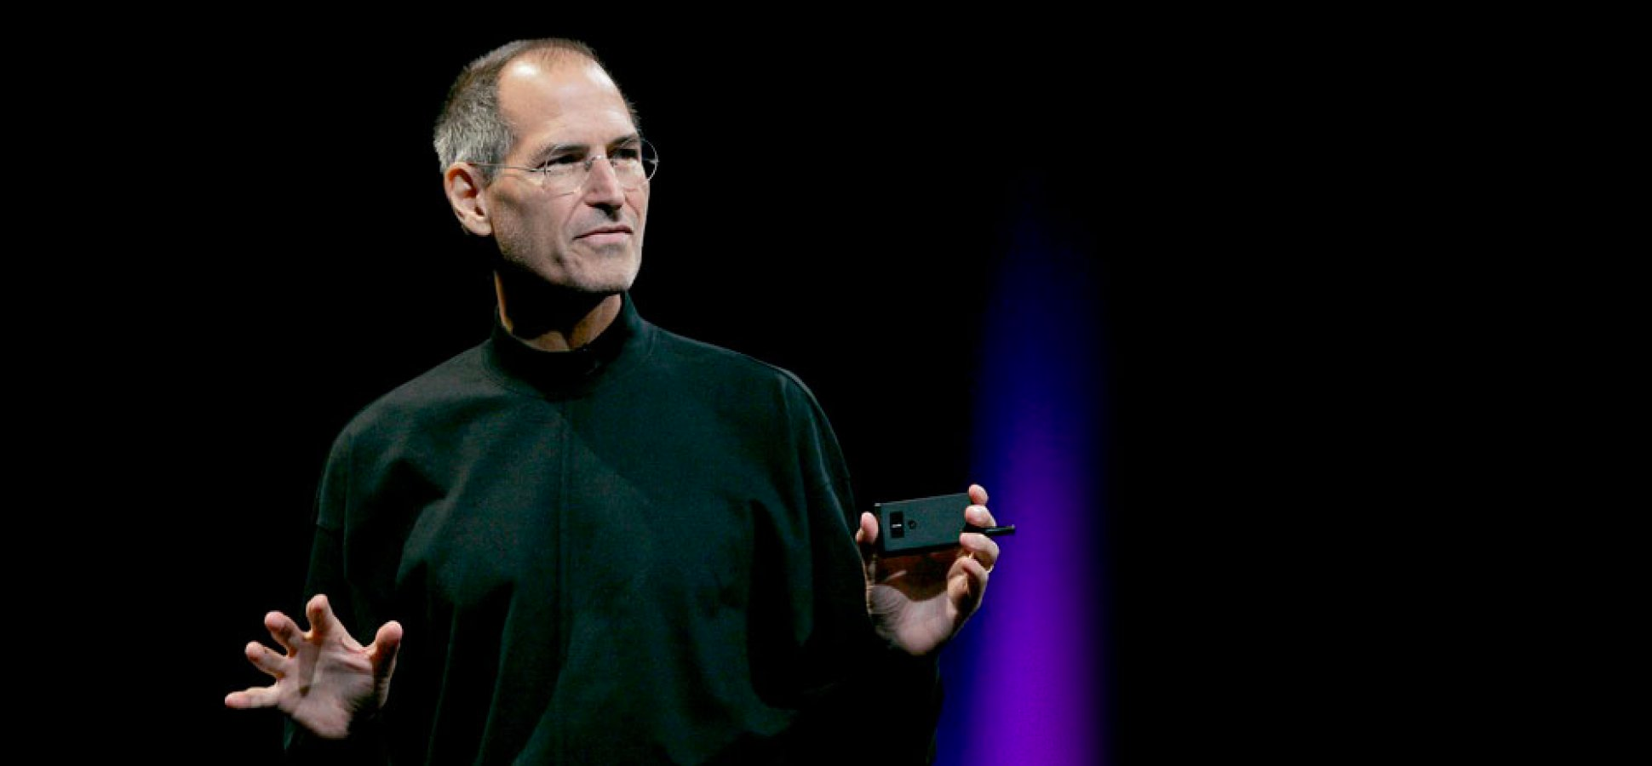

Slide 19
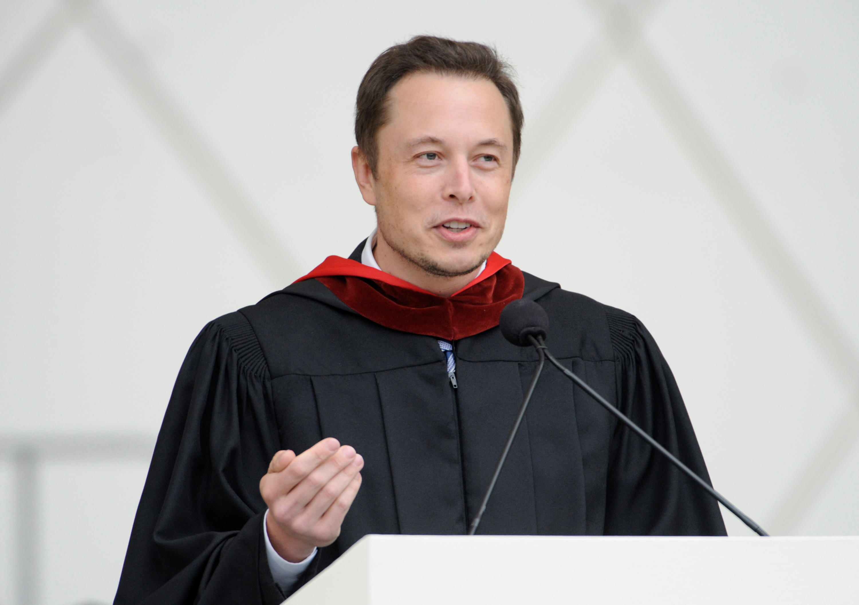

Slide 20
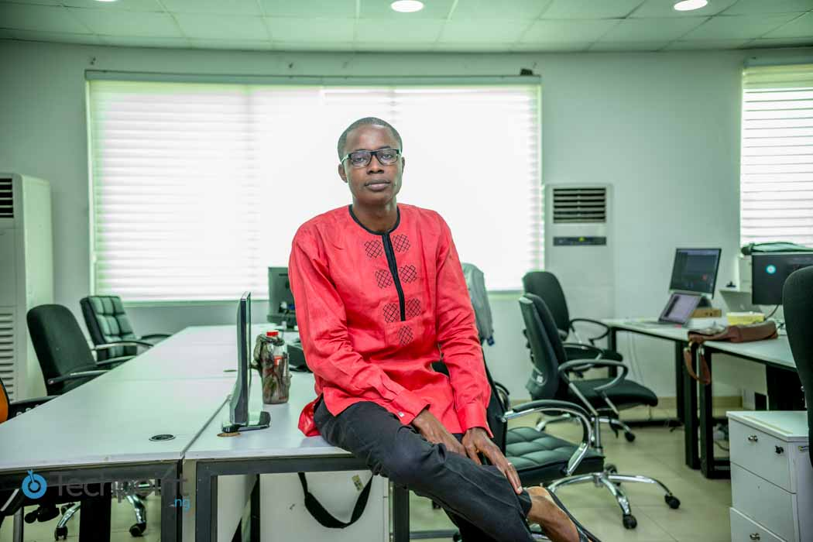

Slide 21
All had top notch mindsets.

Slide 22
“Once your mindset changes, everything on the outside will change along with it.”
–Steve Maraboli

Slide 23
Always remember
There is nothing you can’t build.
There’s no height you can’t get to.
This is just the beginning.
You are world class!

Slide 24
Happy building

